Slide 2
Our livestream service
will begin soon on
Facebook & YouTube
Grab a cuppa, say a prayer
or check our website
www.stmichaelsnc.org.au

Slide 3
Acknowledging the Wurundjeri people
of the Kulin nation as the traditional custodians of the land and paying respect to their elders past,
present and emerging.

Slide 4
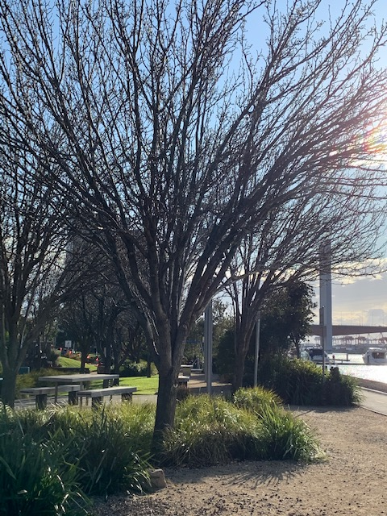
Docklands, near the Bolte Bridge - Traditional lands of the Boonwurrung people.
The history of the Boonwurrung people dates back many thousands of years. To a time when this land that is now called Melbourne extended right out to the ocean. Port Phillip Bay was then a large flat plain where the Boonwurrung hunted kangaroos and cultivated their yam daisy.
(Source: the Boon Wurrung Foundation)
Photo: Kim Messieh

Slide 5
Live-stream worship service
Facebook & YouTube
www.stmichaelsnc.org.au

Slide 6
Agnus Dei
Words and music by Michael W Smith
© 1990 Sony/ATV Milene Music| Used By Permission. CCLI License #209025

Slide 8
A PRAYER OF THANKSGIVING

Slide 9
Gracious God,
We humbly thank you
for life and health and safety,

Slide 10
for freedom to work,
leisure to rest,
and for all that is beautiful
in creation and human life.

Slide 11
But, above all,
we praise you for our Saviour,
Jesus Christ; for his death
and resurrection;

Slide 12
for the gift of your Spirit;
and for the hope of
sharing in your glory.

Slide 13
Fill our hearts with all joy
and peace in believing.
Through Jesus Christ our Lord.
Amen.

Slide 21
Supporting St Michael’s
Account number: 1007 8845
BSB: 063 114

Slide 23
Romans 8:37-39

Slide 25
John 3:16-17

Slide 29
When I Survey
Words and Music by Isaac Watts
© Public Domain| CCLI Licence # 209025

Slide 32
Heavenly Father,
You have loved us
with an everlasting love,
but we have broken
your holy laws

Slide 33
and have left undone
what we ought to have done.
We are sorry for our sins
and turn away from them.

Slide 34
For the sake of your Son
who died for us,
forgive us, cleanse us
and change us.

Slide 35
By your Holy Spirit,
enable us to live for you;
through Jesus Christ our Lord,
Amen.

Slide 37
THE GREETING OF PEACE
We are the body of Christ;
His Spirit is with us.

Slide 38
The peace of the Lord be always with you;
And also with you.

Slide 39
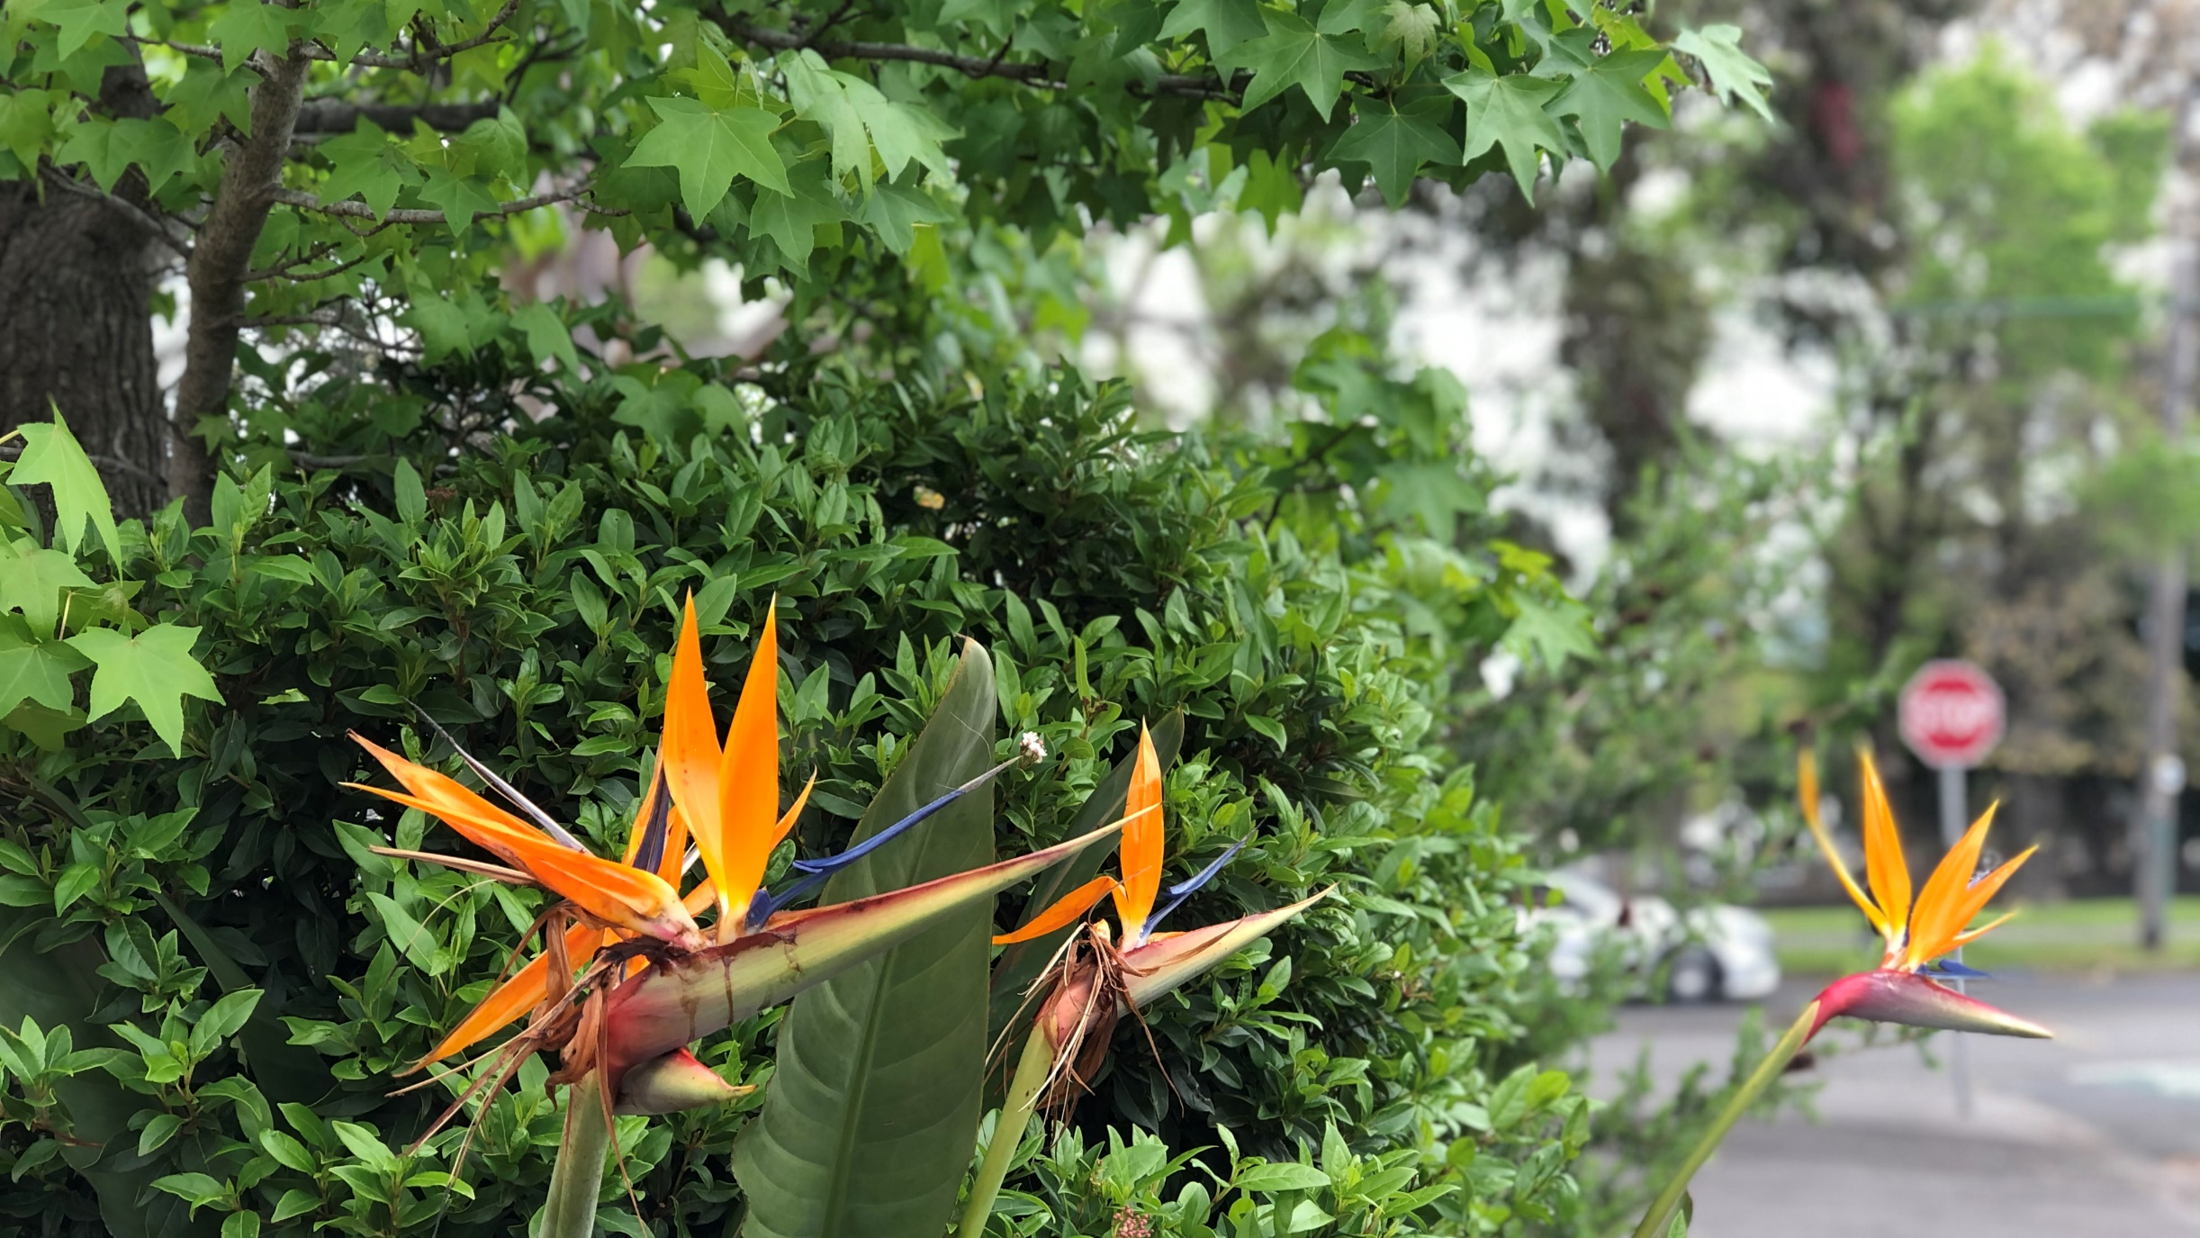

Slide 43
Let’s say The Lord’s Prayer together…
Our Father in heaven,
hallowed be your name,
your kingdom come,

Slide 44
Your will be done,
on earth as in heaven.

Slide 45
Give us today our daily bread.
Forgive us our sins
as we forgive those
who sin against us.

Slide 46
Save us from the time of trial
and deliver us from evil.

Slide 47
For the kingdom, the power
and the glory are yours
now and for ever.
Amen.

Slide 49
Take us and use us
to love and serve
you and all people,

Slide 50
in the power of your Spirit,
and in the name of your Son,
Jesus Christ our Lord,
Amen.

Slide 51
Revelation Song
Words and Music by Jennie Lee Riddle
© 2004 Gateway Create Publishing (SHOUT! Music Publishing Australia)| CCLI Licence # 209025

Slide 54
Go in peace to love
and serve the Lord.
In the name of Christ. Amen.

Slide 55
Alex, Elizabeth, Fred, Sarah, Kyria, Sam, and Steve

